Slide 1
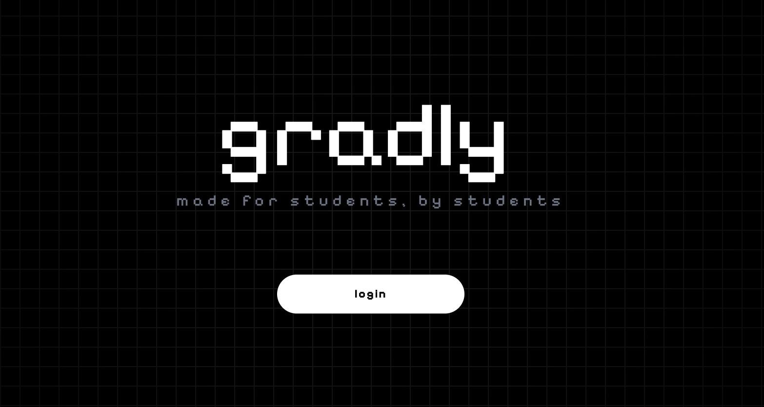
Gradly
Long-Term Academic Planning Platform for UC Students
Team: Saksh Menon, Kshitij Maurya
Advisor: Sonam Kandoi — IT Lead @ HelloFresh

Slide 2
The Problem with Current Planning
Fragmented Systems
Unreliable Platform
Students rely on multiple disconnected tools just to check availability, track requirements, and compare schedules
Catalyst crashes during critical scheduling periods, creating stress and missed opportunities
Short-Term Focus
Limited Coordination
Planning happens last-minute instead of mapping multi-semester academic paths
Taking classes with friends requires texting, sharing screenshots, and manual comparison

Slide 3
Why Students Need Better Planning
The Reality
Gradly's Solution
Students plan too late in the semester
Course offerings vary dramatically by term
Advisor availability is limited during peak times
Coordinating with peers is manual and time-consuming
Poor planning near graduation creates cascading problems
Centralized, long-term academic roadmap
Proactive planning instead of reactive scheduling
Peer coordination built into the platform
Informed decisions made months in advance
Reduced risk of delayed graduation

Slide 4
What Makes Gradly Innovative
Auto-Scheduler
Peer Collaboration
Intelligent algorithm generates reasonable multi-semester scheduling options, reducing manual planning effort from hours to minutes
Connect with classmates, view compatible schedules, and coordinate course selection within one unified platform
University-Focused
Student Reviews
Built specifically for UC students with institutional context, not a generic tool retrofitted for academia
Class rankings, professor ratings, and peer feedback provide actionable insights beyond static course catalogs

Slide 5



System Architecture Overview
Next.js Frontend
Backend API
Python Engine
TypeScript-based interface with responsive design
SQL database management and core logic
Scheduling algorithms and data processing
Dashboard
Planner
Social Features
Class Info
Degree progress, semester tracking, GPA, alerts
Multi-semester scheduling and long-term roadmap
View, copy, and compare peer schedules
Course discovery with peer ratings and reviews
Profile
Academic info, major, preferences, starting term

Slide 6
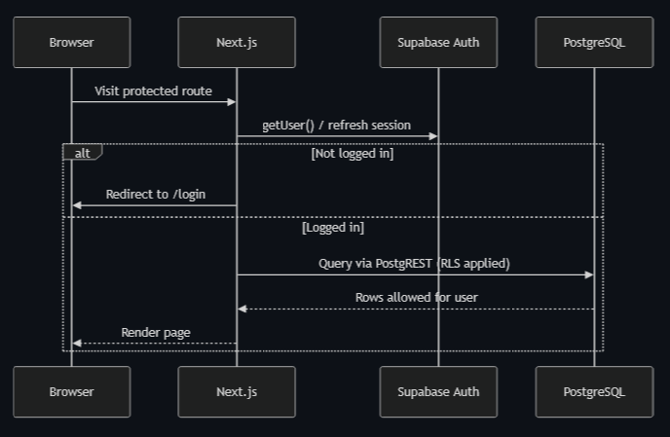
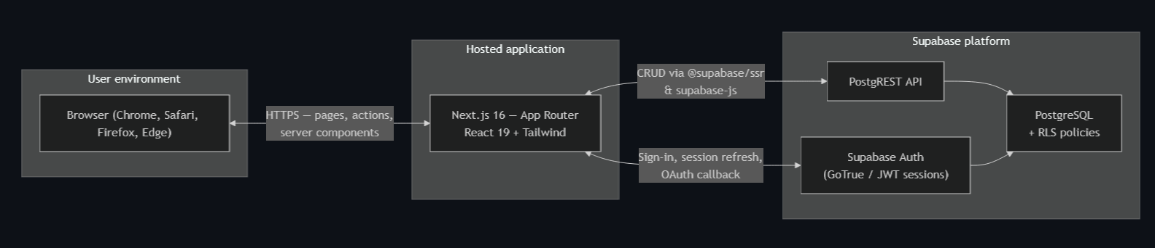
Technical Implementation
Core Technologies
Design Priorities
Built primarily in TypeScript using the Next.js framework for modern web development structure and responsive interface design.
Scalability for growing user base
Modularity for feature expansion
Clean UI/UX principles
Academic planning clarity
Backend supported by SQL-based systems managing academic and user data. Python scripts handle class offering retrieval, scheduling logic, and data processing.

Slide 7

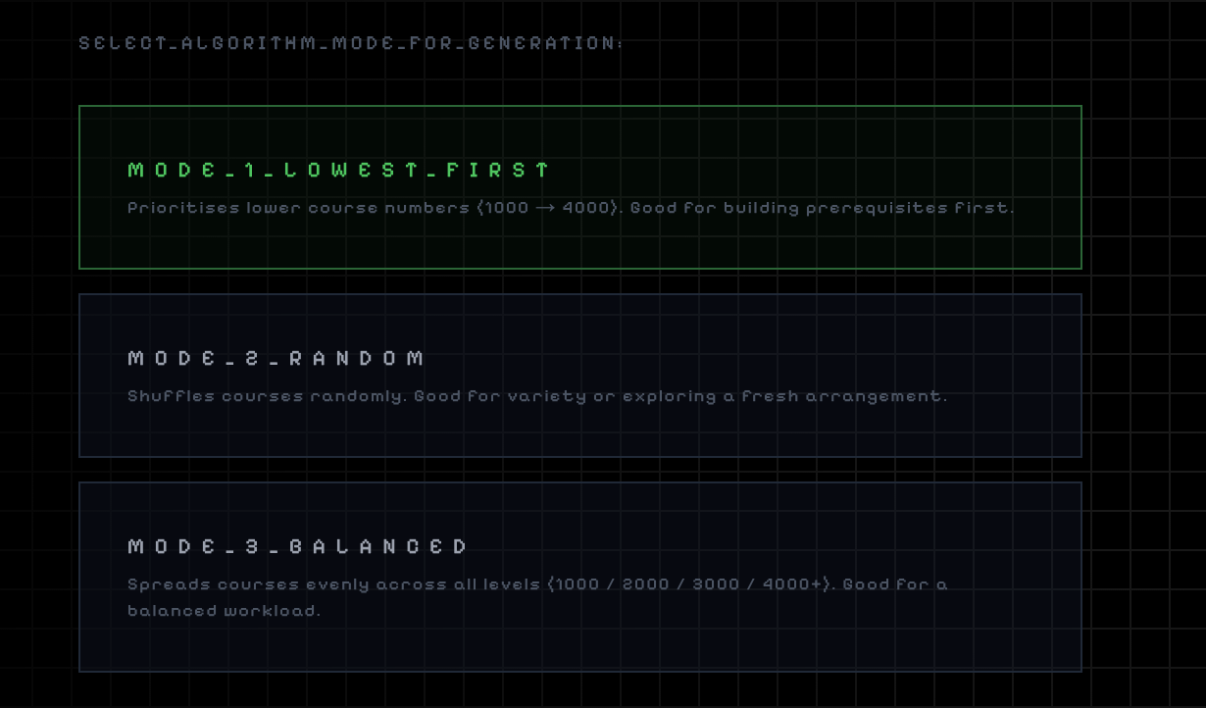
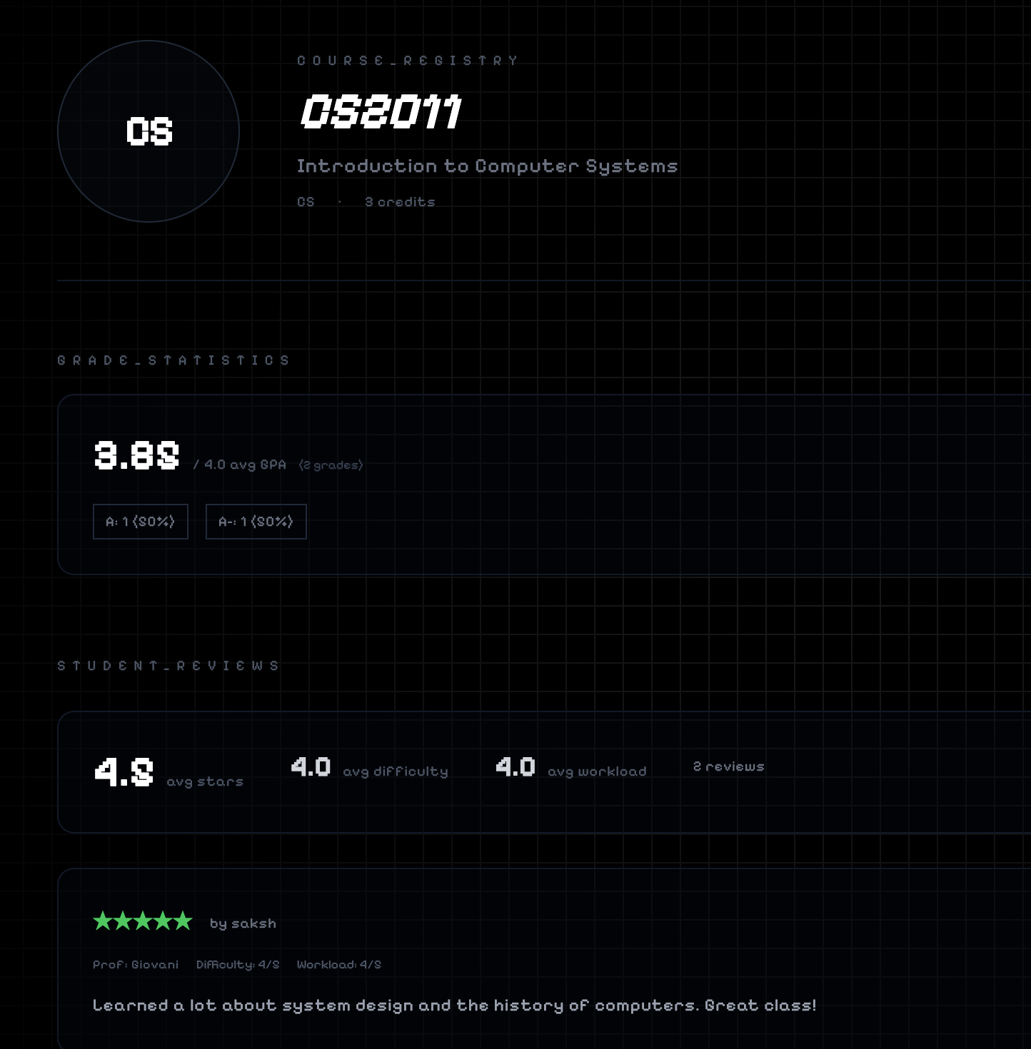
Key Features We're Proud Of
Auto Scheduler
Peer Reviews
Copy Schedule
Long-term planning reduces manual schedule building from hours to minutes with intelligent recommendations
Class and professor insights from actual students support better decision-making with real experiences
Users adopt or compare peer schedules, simplifying coordination with classmates and friends

Slide 8
Development Milestones
Framework Setup
1
Next.js foundation and TypeScript architecture
2
Authentication
Login and sign-up system implementation
Profile & Class Data
3
User profiles and course information management
4
Planner & Search
Long-term scheduling with search capabilities
Auto Scheduler
5
Intelligent multi-semester planning algorithms
6
Social Features
Peer connections and Copy Schedule functionality
Class Reviews
7
Student feedback and rating system integration

Slide 9
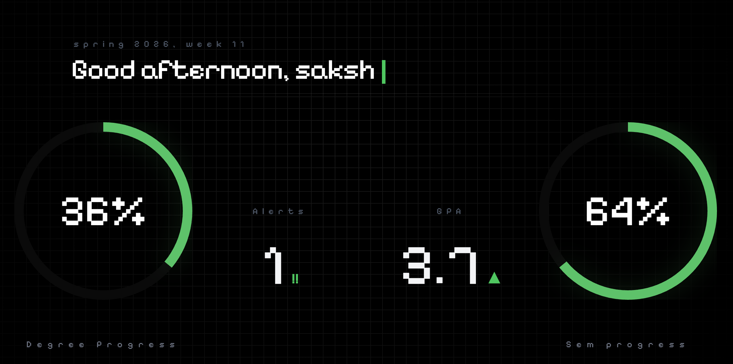
Results & Future Vision
Completed Features
Future Roadmap
Fully functional social platform for academic planning
Intelligent class auto-scheduling with multi-semester support
Peer connections and schedule coordination
Class reviews with student-generated feedback
Collaboration with UC IT department
Improved institutional data integration
Enhanced course data reliability
Expanded scheduling intelligence

Slide 10
Project Challenges & Conclusion
Algos for Scheduling
Implementing Class Restrictions
Retrieving the classes autonomously
Ideating and implementing differing variants of our algo
Working around restrictions for scheduling
Navigating UC Class Search With Session Hijacking
Despite these challenges, we were able to build a working system that demonstrates the potential of smarter academic planning tools.
By combining automation, peer collaboration, and long-term planning tools, Gradly helps students make better academic decisions and stay on track toward graduation.
Conceptualizing algorithms for auto-scheduling
"From fragmented tools to unified planning — Gradly helps UC students take control of their academic journey."

